Slide 1
How to Pwn an Enterprise in 2015
2016
By Johnny Xmas - @j0hnnyXm4s
2017
(…probably 2018)

Slide 2


// Security Researcher @ Uptake
Performing ICS / SCADA Research (Read: hacking)
Identifying flaws and vulnerabilities in ICS, writing exploits, and developing defenses against them
Johnny
Freakin’
Xmas
// Penetration Tester @ Redlegg
Contracted assessment of physical, digital and cultural security postures at companies ranging from SMB to Global 1000
General consultation on Governance, Risk & Compliance, along with all other aspects of information security
// Security Engineer @ Officemax
Engineering of security systems for a Fortune 500 / Global 1000 enterprise
Implemented such security solutions as DLP, Password Management, Content Filtering Proxy, Wireless IDS, and much more
// Founder & Coordinator @ BurbSec
Core staff for Chicago’s most consistently-attended Information Security meetups
Founder of BurbSec East, the second-largest of the groups
// Public Persona & Infosec Diva @ *
Given over 60 presentations in 6 countries on the topics of Technology, Information Security, Privacy and Career Advancement
Makes angry, satirical comments on twitter (@j0hnnyxm4s)
Director of Entertainment & Social Media for CircleCityCon
Referenced & interviewed in nearly every major technology media outlet
The TSA Keys Guy

Slide 3
Why.
Am.
I.
Here?
Your Security Posture is Bad and You Should Feel Bad.
You Make Being a Pentester BORING.
Notes:
The steps I list here are not effective against all environments. Unfortunately, they were affective against a vast majority of the environments we came across, including Fortune 500s. In fact, the larger the organization, the more we found them susceptible.

Slide 4

Ok,
So
Now what?
Pick Your Low-Hanging Fruits
Before the Attackers Can
But first:
Let’s learn how they operate.

Slide 5
Intelligence Gathering
Post-Exploitation
PENETRATION
TESTING
EXECUTION
STANDARD
http://www.pentest-standard.org/
Exploitation
c

Slide 6
FIRST & FOREMOST
// “REAL” ATTACKERS
LIVE OFF THE LAND
Notes:
Malware is only used as a last resort
“Importing” hacking tools is often a PITA, and not necessary when the OS provides everything needed
Blinky boxes don’t work against “legitimate” activities like successful logins, null sessions, and access that doesn’t require elevated privileges
Attackers rarely exploit known vulnerabilities, or even burn 0Days. They exploit lazy / overworked sysadmins.
we don’t use kali

Slide 7
RECON

Slide 8
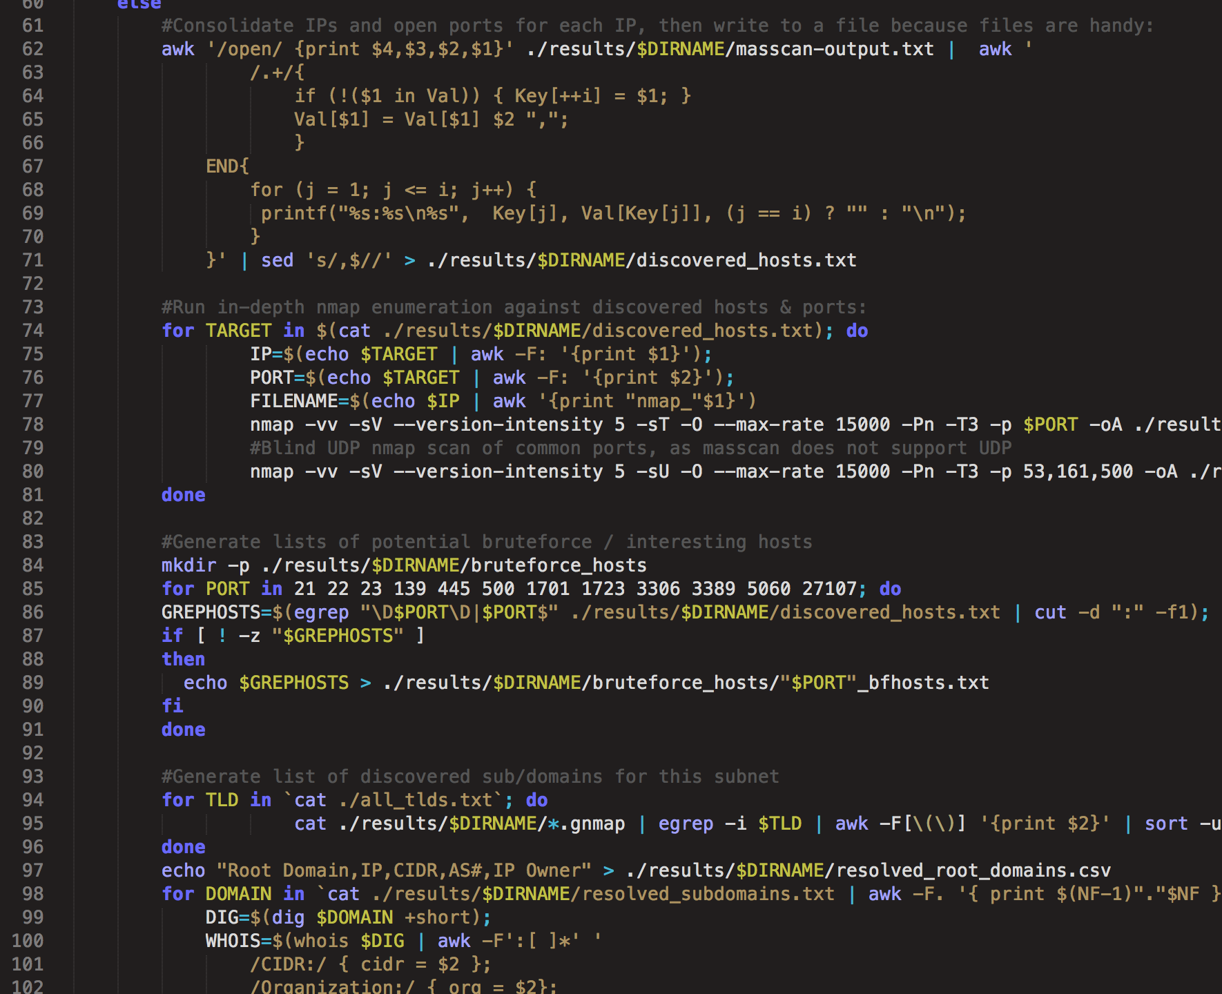
RE
CON NAIS
SANCE
SCANCANNON
Notes:
We’re primarily looking for AD logins (on next slide)

Slide 9
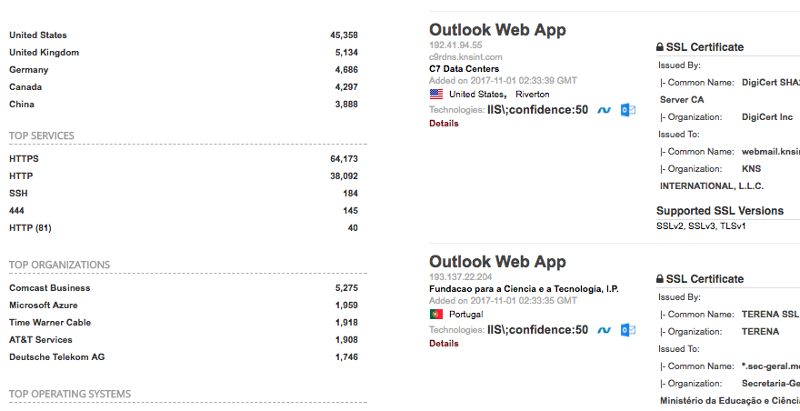
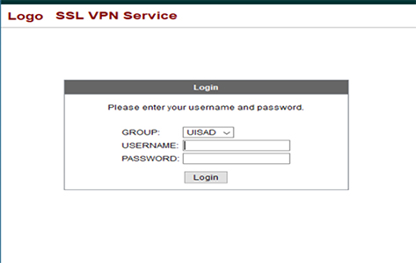
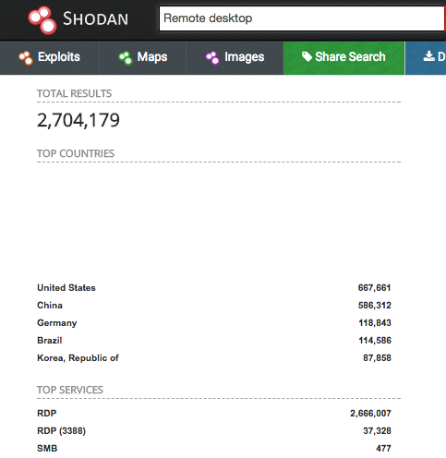
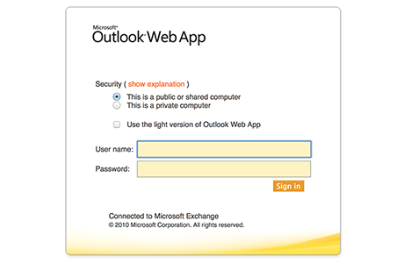
RE
CON NAIS
SANCE
AD LOGINS
Notes:
What are we looking for? AD logins. What do we need for these? Creds

Slide 10
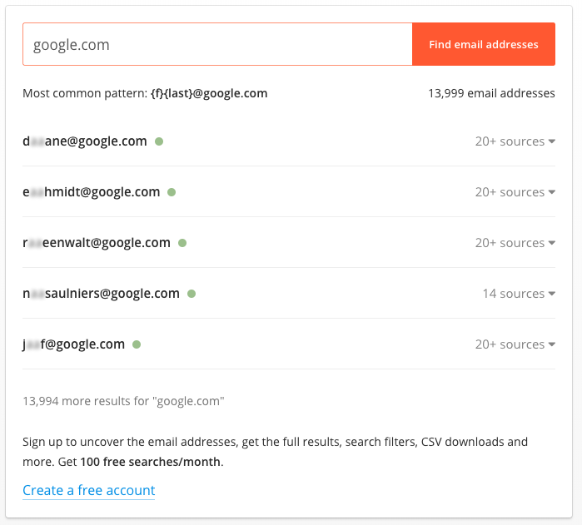
RE
CON NAIS
SANCE
HUNTER.IO
Notes:
Also data.com

Slide 11
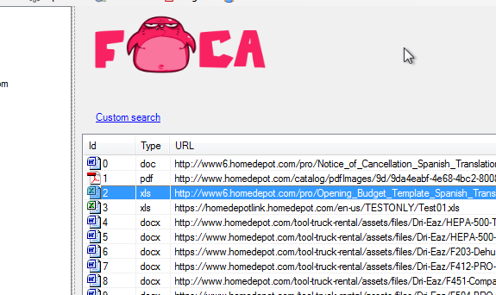
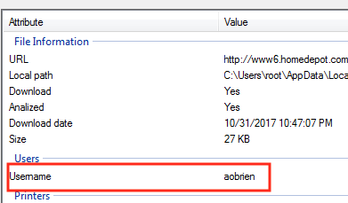
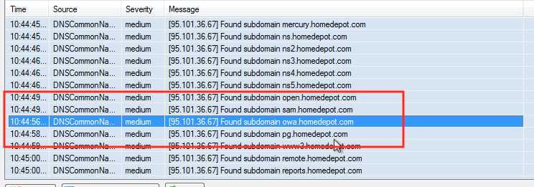
RE
CON NAIS
SANCE
FOCA
Notes:
Also recon-ng & theharvester

Slide 12
RECON DEFENSE
// Port \ Service Scans
Find it first!
Know your assets!
Google \ Shodan \ FOCA yourself
Write alerts for what you can’t clean
// Private Data Gone Public
Find it first!
Recon-NG Yourself!
Pastebin alerts!
Have Legal Issue Takedowns
(Nothing, really)

Slide 13
c
EXPLOITATION
Notes:
Notice how we never ran a vulnerability scan
OK, so we have our target AD logins, we have our usernames, but. . .how do we get passwords?

Slide 14
PSYCHIC
POWERS
DEMO

Slide 15
COMM
MMON
PASS
WORDS
Crap
More Crap
Other Crap
Spring2017
Summer2017
Fall2017
Spring17
Summer17
Fall17
Spring17!
Summer17!
Fall17!
Password
Password1
Password!
Password1!
Password2017
Password17
Password17!
Fuck{companyname}
{CompanyActivity}
Notes:
The Word(space)number awareness issue. Discuss Cewl. HaveIbeenpwned

Slide 16
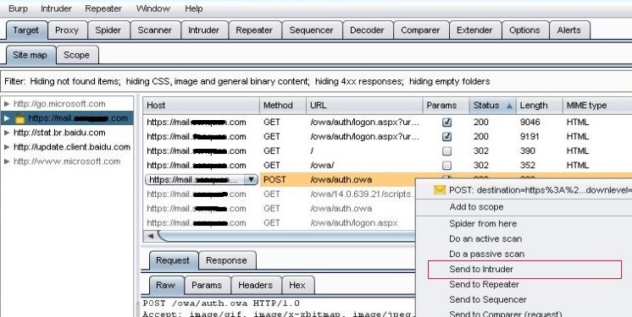
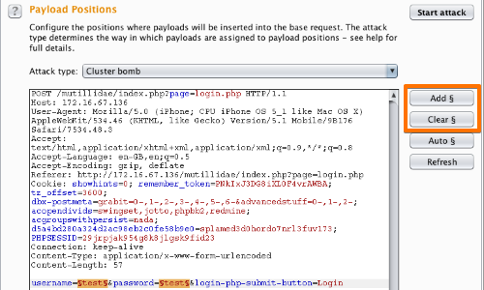
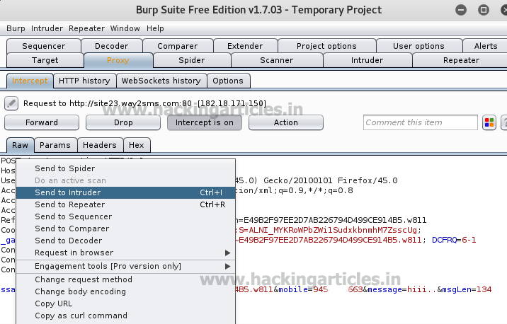
EX
PLOI
TA
TION
BURPSUITE
Notes:
Discuss also being able to suss out account lockout policies once a single hit has been obtained (increases bruteforcing accuracy )
Also mention, Hydra for RDP, ike-force for VPN, Metasploit for everything (incl. domain discovery via ntlm)

Slide 17
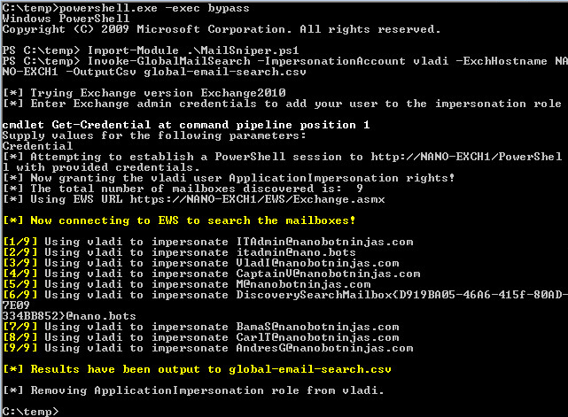
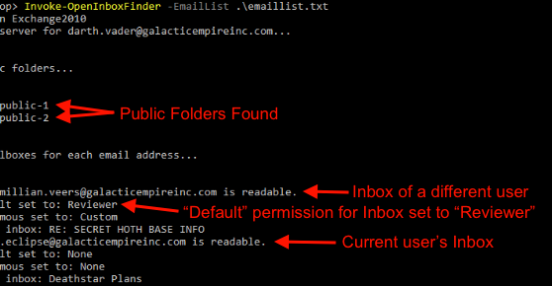
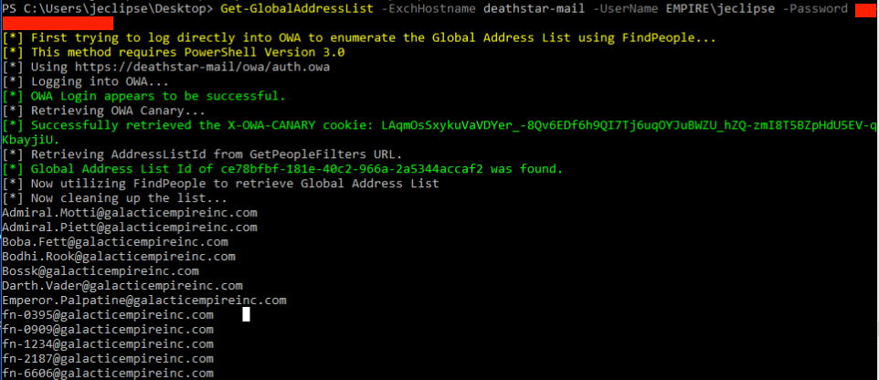
EX
PLOI
TA
TION
MAILSNIPER
Notes:
1. MailSniper is a penetration testing tool for searching through email in a Microsoft Exchange environment for specific terms (passwords, insider intel, network architecture information, etc.). It can be used as a non-administrative user to search their own email, or by an Exchange administrator to search the mailboxes of every user in a domain.

Slide 18

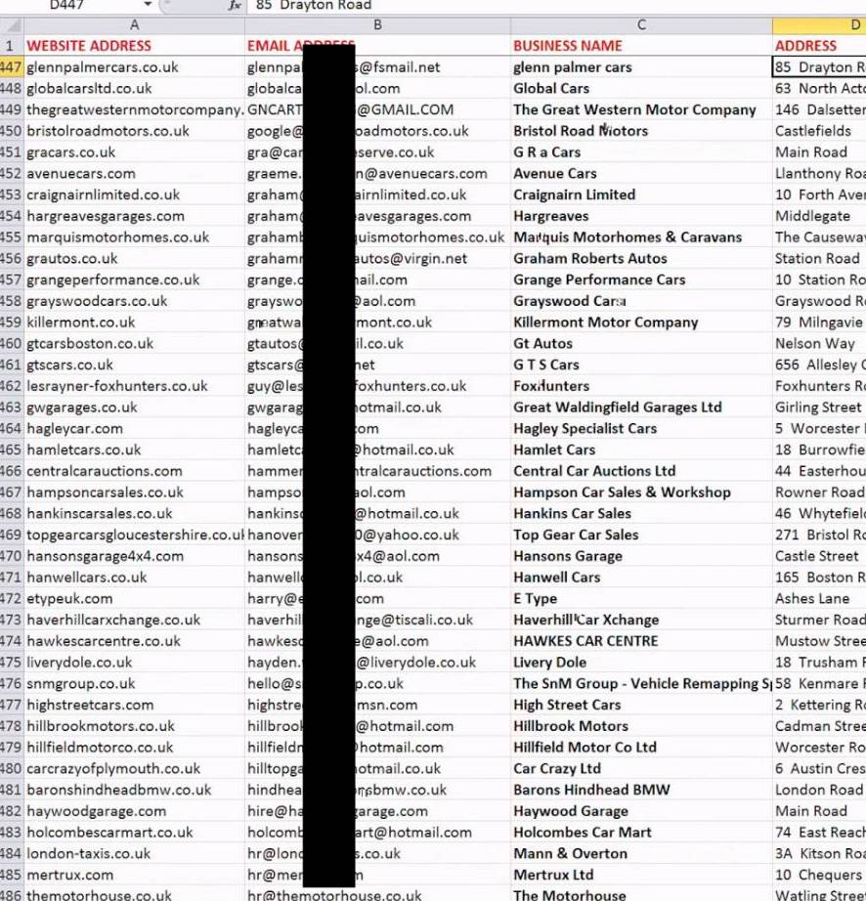
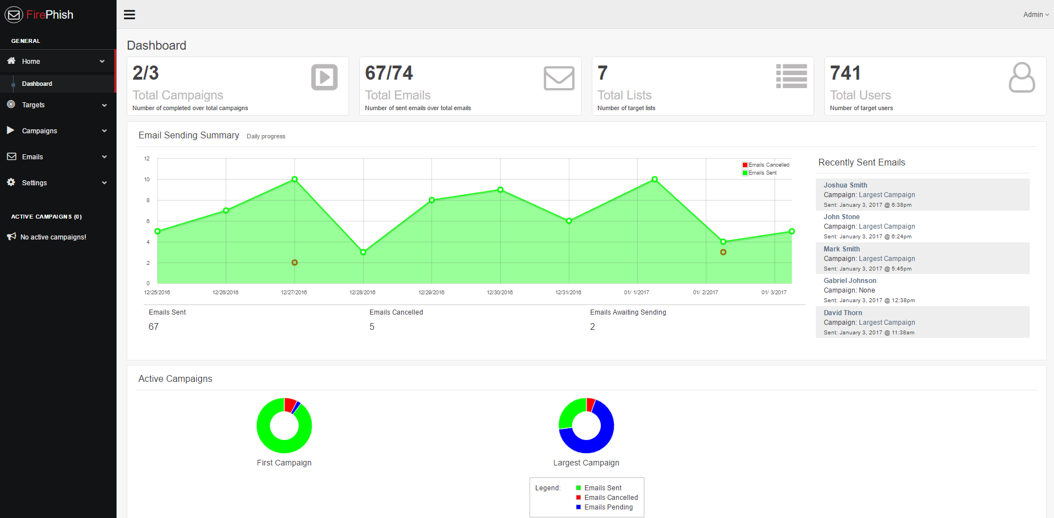
EX
PLOI
TA
TION
FIERCEPHISH
Notes:
Phishing does’t work because your users are stupid, it works because they don’t give a shit Lets talk about how to better prevent phishing from working

Slide 19
EXPLOIT DEFENSE
// Phishing
Awareness training (yawn)
Phish Yourself
Make users take ownership
Offer pos. and neg. reinforcement
Does HR enforce your AUP?
// Bruteforcing / Guessing
MFA Solution
Lockdown EWS queries
Alert on anomalous traffic volumes
Notes:
( 1/2 )
Discuss ant trap issue

Slide 20
EXPLOIT DEFENSE
// Password Bias \ Reuse
Awareness training!
Use whole sentences
No dictionary words in short PWs
No patterns!
No U=P !
> 14 characters+
ENFORCE THIS.
AUDIT YOUR HASHES
Check for dupes
Notes:
( 1/2 )
Discuss ant trap issue

Slide 21
POST
EXPLOITATION

Slide 22
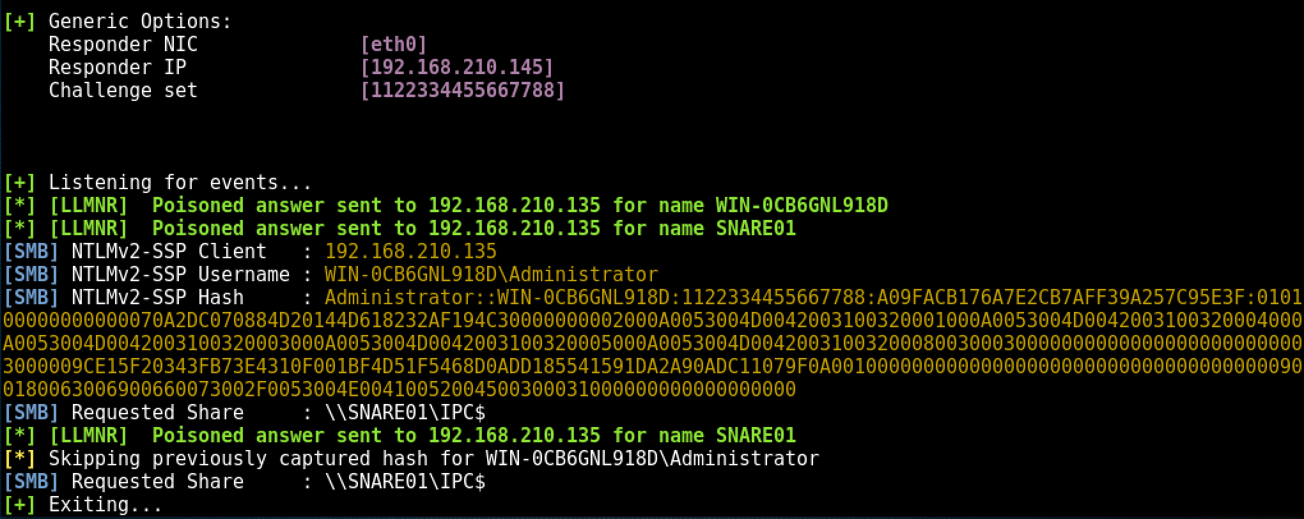
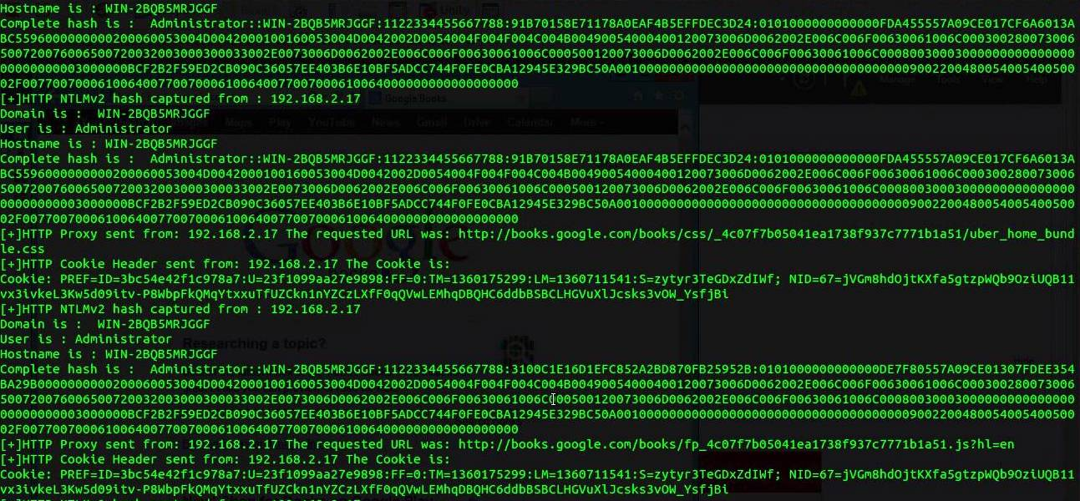
EX
PLOI
TA
TION
RESPONDER
Notes:
Fire this up while doing other stuff. Avoid advanced MITM for now.
These hashes cant be passed
Discuss how password cracking doesn’t require some massive rig. Cracking onsite with MBP. Password bias.

Slide 23
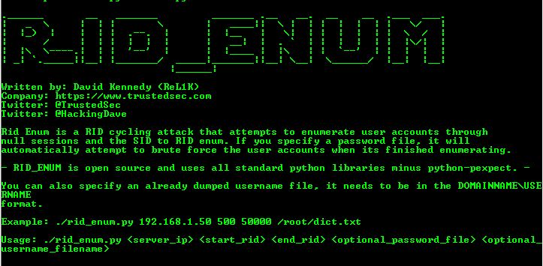
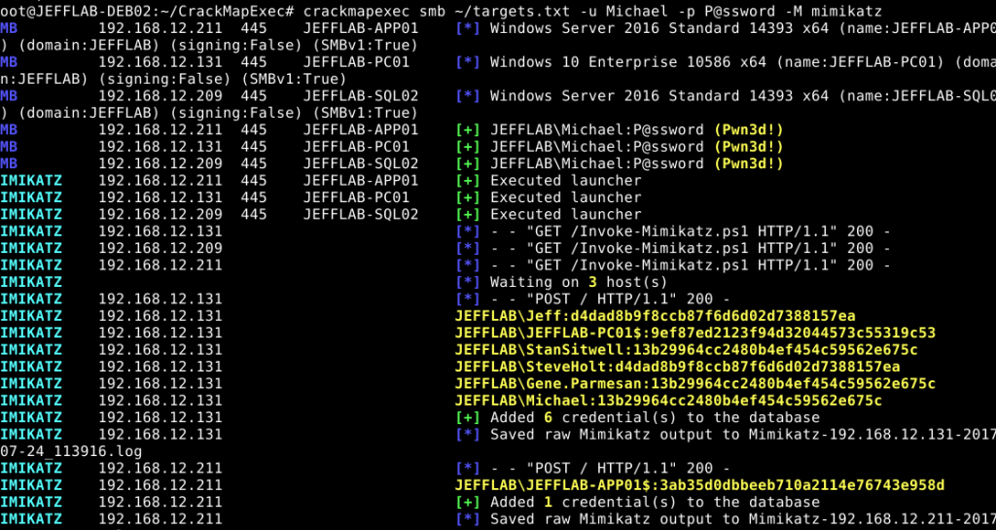
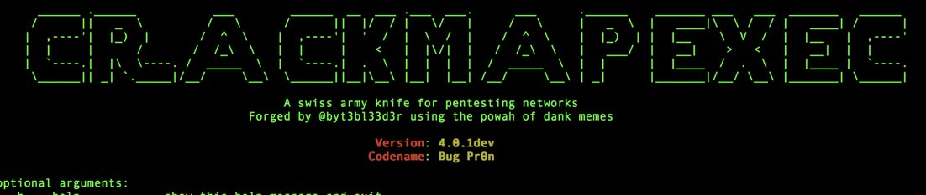
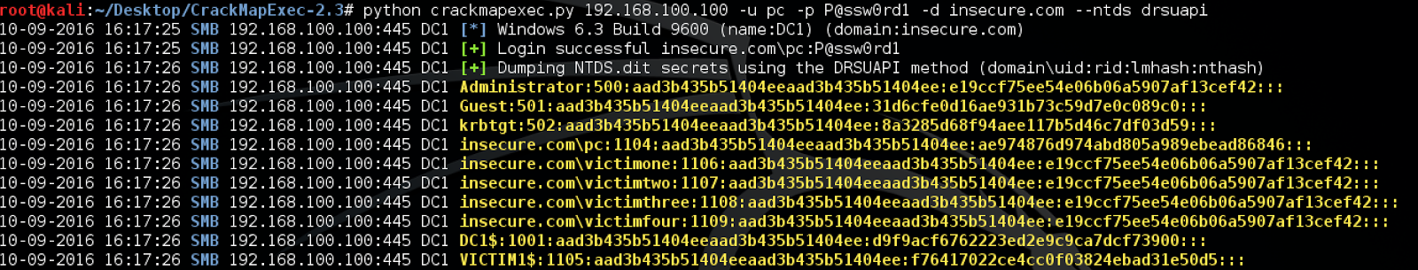
POST
EX
PLOI
TATION
SMB & WMI SMB
Notes:
R_ID_Enum (Dave K) enumerates AD usernames (more brute forcing!) Not necessary (we already have creds & can just query AD), but good for is you got in another way
CME finds open shares & other stuff (gets super dangerous w creds - can even retrieve password hashes & sometimes plaintext passwords
^These are the passable NTLM hashes!
Nobody monitors WMI

Slide 24
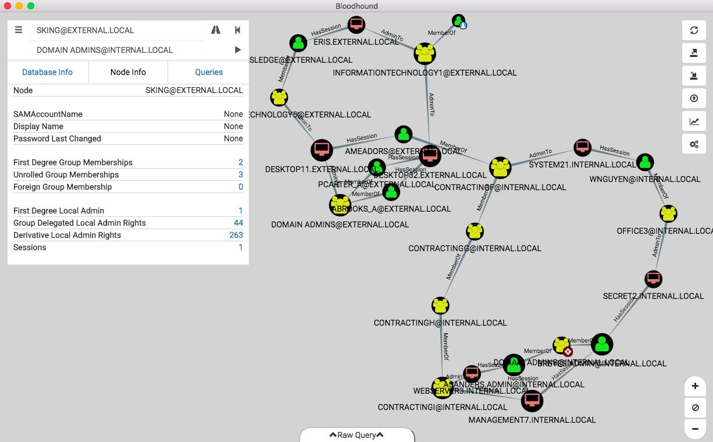
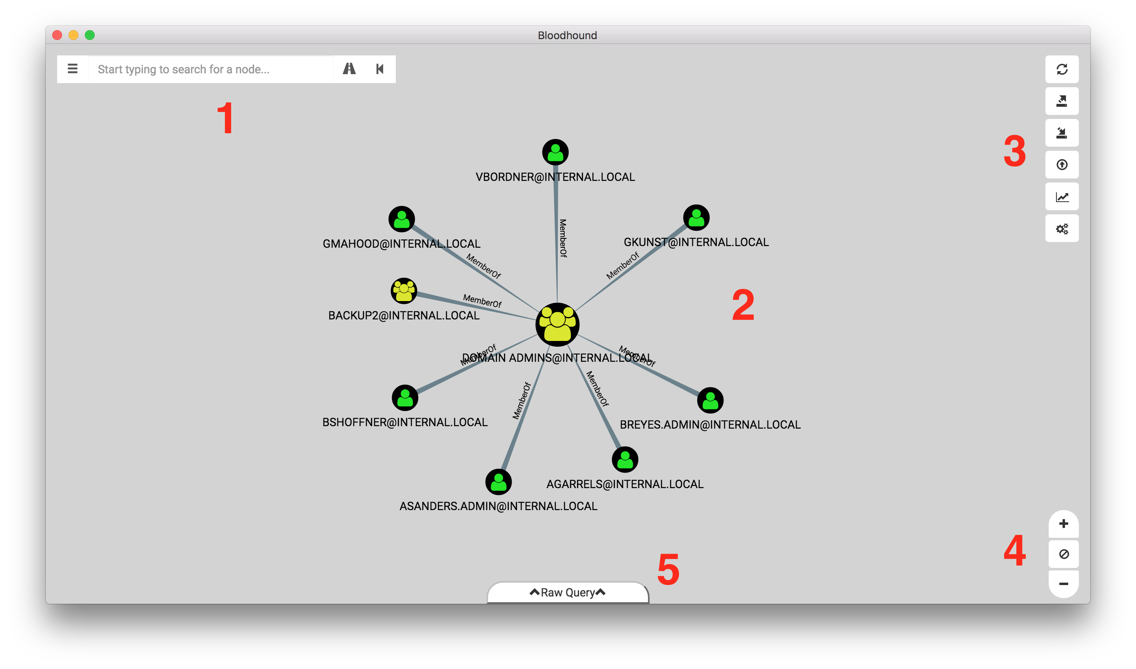
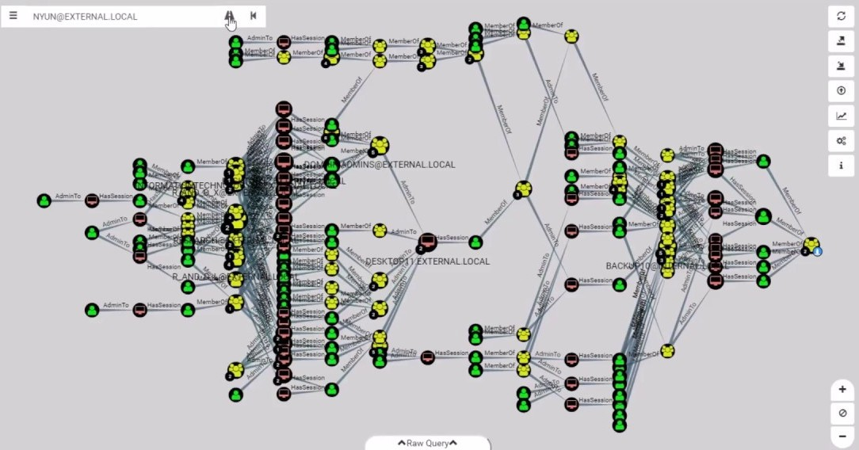
POST
EX
PLOI
TATION
BLOODHOUND

Slide 25
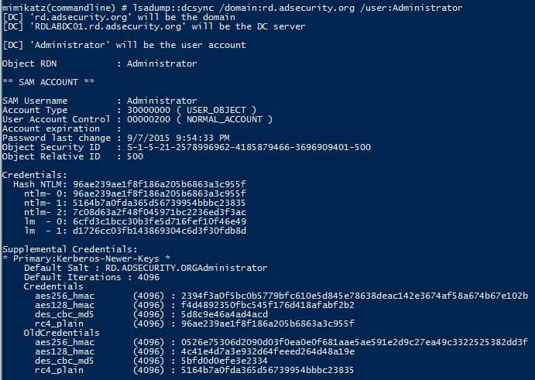
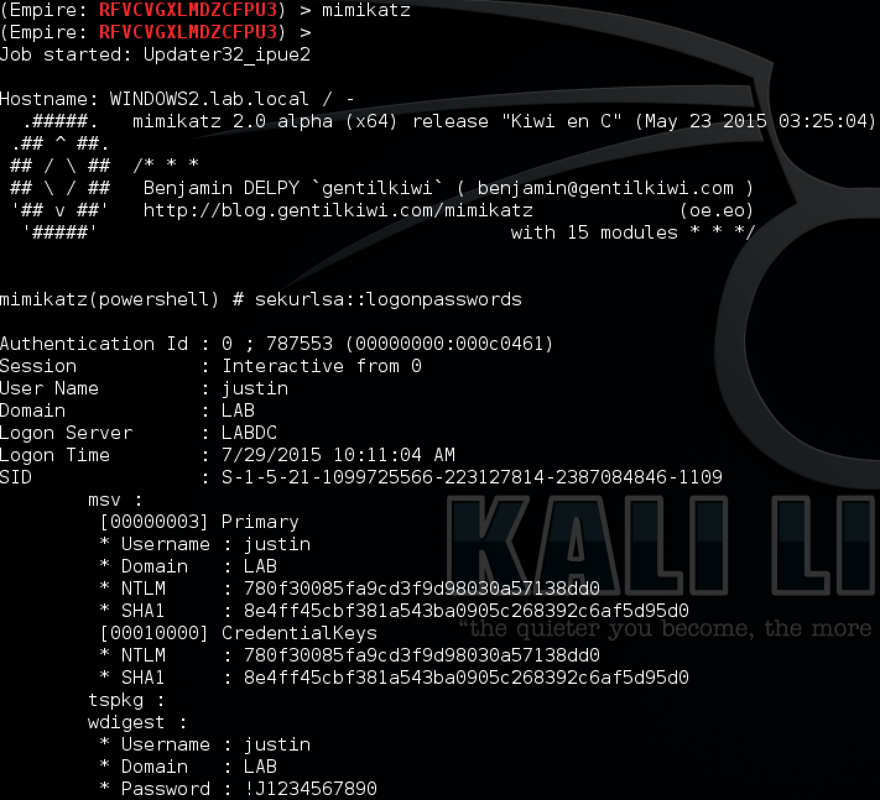
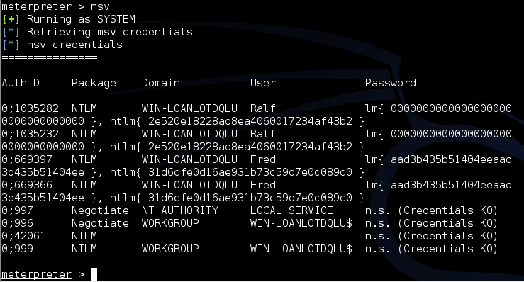
POST
EX
PLOI
TATION
MIMIKATZ
Notes:
First thing an attacker does once local admin is gained is dump lsass, run it through mimikatz offline, and get the passwords.

Slide 26
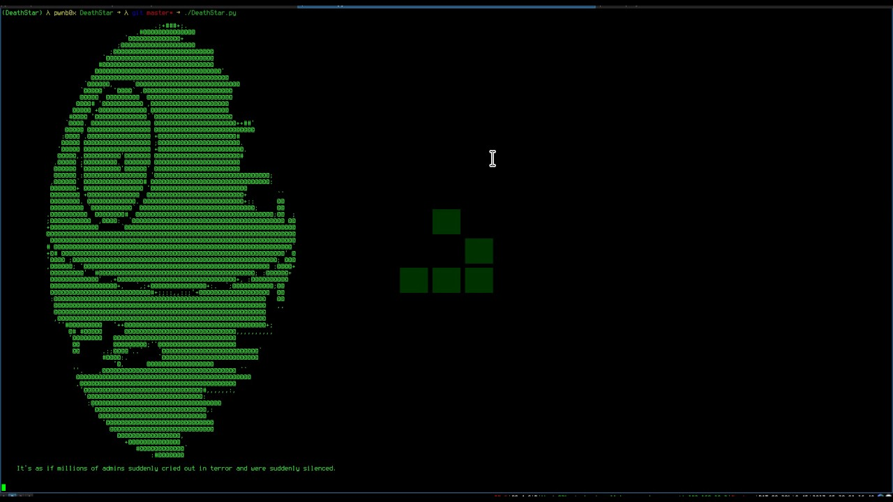
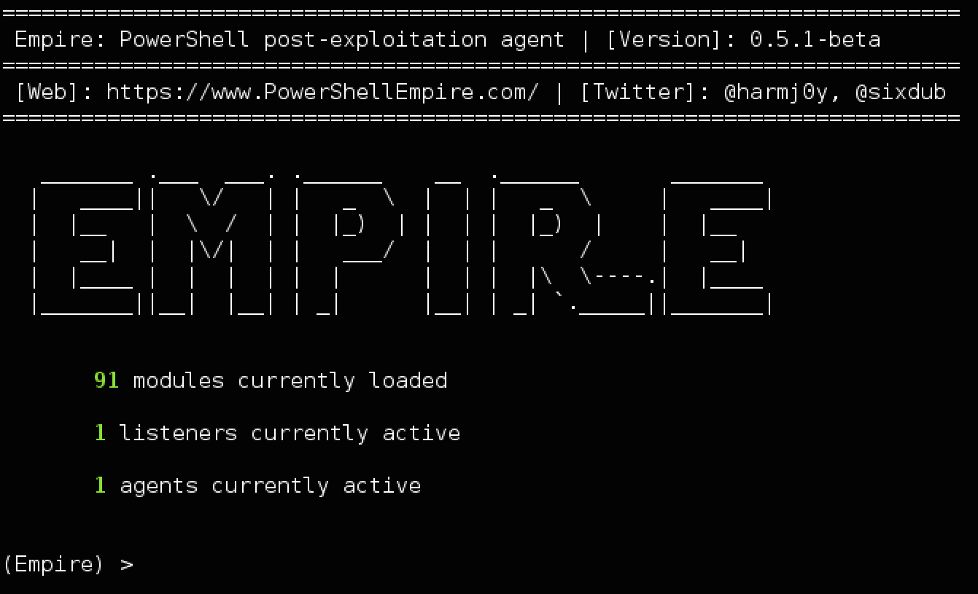
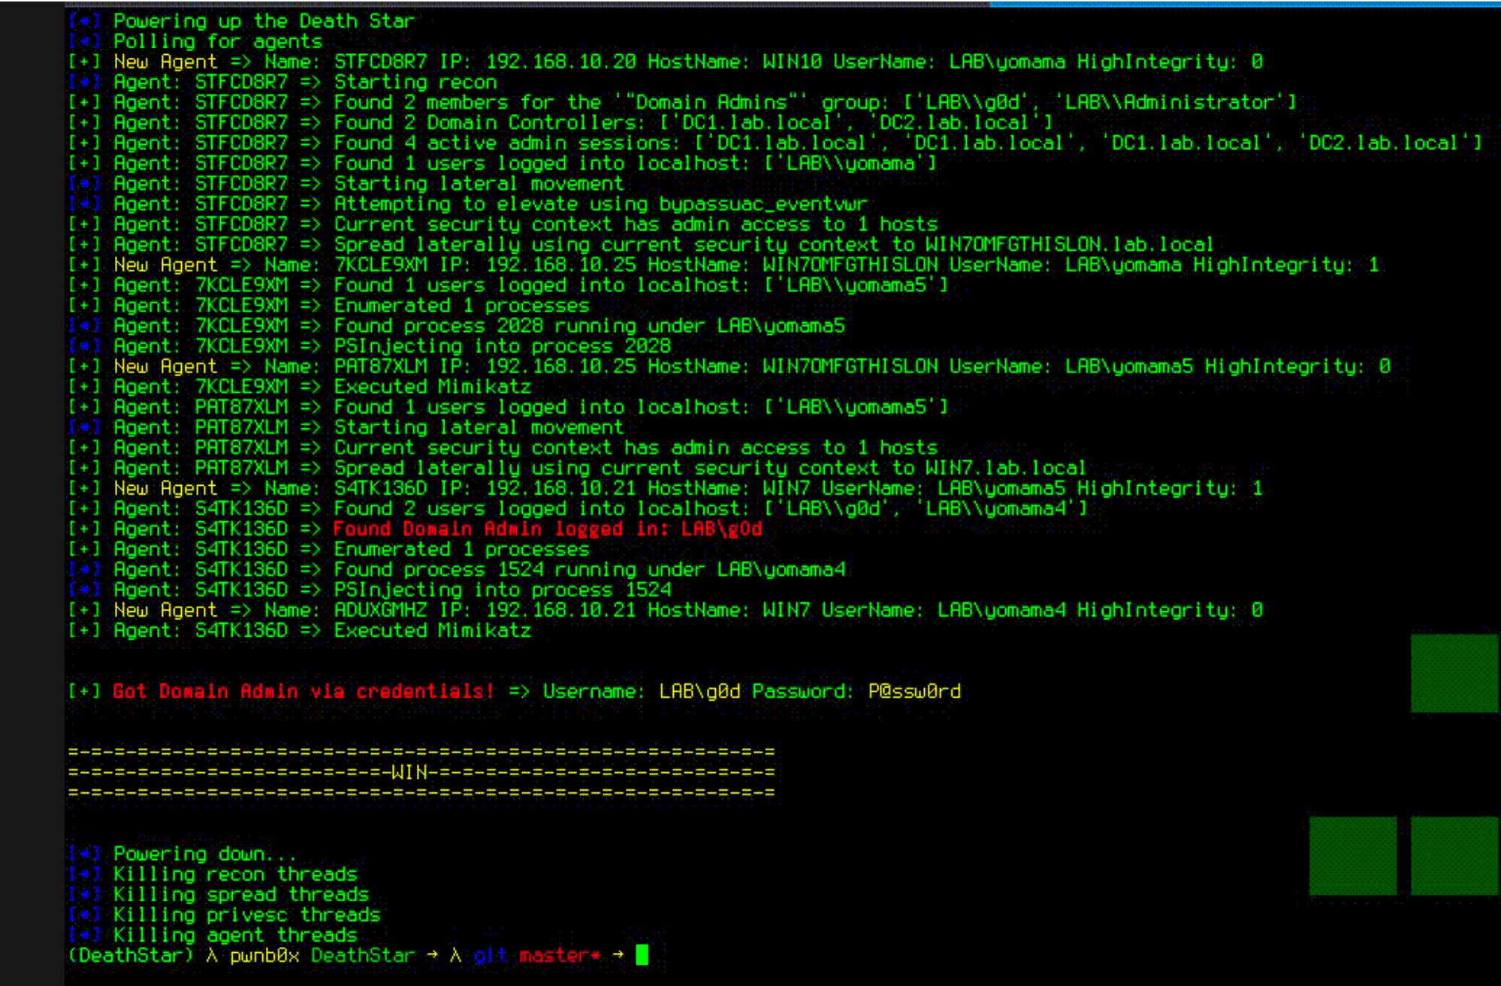
POST
EX
PLOI
TATION
EMPIRE\DEATHSTAR
Notes:
JFC this is hilarious and vicious.
Effectively does Bloodhound them CME
Its extremely noisy but. . . . . . that never seems to be an issue :(

Slide 27
POST-EXPLOIT
DEFENSE
// Responder
Disable WPAD, LLMNR, NBT-NS & mDNS
Roll out SMB signing
SpoofSpotter?
// SMB, WMI & AD Null Sessions
Just don’t
Scan your environment to find them
If you do need them, set ingress rules
Notes:
All of this may break stuff. Printers are a huge culprit (but are getting better)

Slide 28
POST-EXPLOIT
DEFENSE
// Bloodhound
RUN IT FIRST!
Alert on anomalous traffic volume to a single DC
Set query limit on the DC
Javelin?
// Mimikatz
Alert on “lsass.dmp” file creation
Stop giving everyone and their dog Local Admin privs
Notes:
Use Bloodhound to locate problems before attackers do
Query limit may break stuff. Printers are a huge culprit (but are getting better)

Slide 29
POST-EXPLOIT
DEFENSE
// Rampant Local Admin
Grow a spine
Admin account should not be the “daily driver”
Use granular rules to only allow certain tasks to “Run as Admin”
Use IAM vaults such as CyberArk to “check out” admin rights
Notes:
Use Bloodhound to locate problems before attackers do
Query limit may break stuff. Printers are a huge culprit (but are getting better)

Slide 30
APPEN
DIX:
TOOLS
OF
NOTE
ScanCannon
Shodan
Hydra
https://github.com/johnnyxmas/ScanCannon
https://www.shodan.io/
https://www.thc.org/thc-hydra/
Evil Foca
Recon-ng
TheHarvester
https://www.elevenpaths.com/labstools/evil-foca/index.html
https://bitbucket.org/LaNMaSteR53/recon-ng
https://github.com/laramies/theHarvester
MailSniper
Burp Suite
FiercePhish
https://github.com/dafthack/MailSniper
https://portswigger.net/burp/freedownload
https://github.com/Raikia/FiercePhish
IkeForce
Metasploit
CrackMapExec
https://github.com/SpiderLabs/ikeforce
https://www.metasploit.com/
https://github.com/byt3bl33d3r/CrackMapExec

Slide 31
APPEN
DIX:
TOOLS
OF
NOTE
(cont.)
Rid_enum
Bloodhound
Mimikatz
https://github.com/trustedsec/ridenum
https://github.com/BloodHoundAD/BloodHound/wiki/Getting-started
https://github.com/gentilkiwi/mimikatz/releases
Powershell Empire
Deathstar
Javelin
https://www.powershellempire.com/
https://github.com/byt3bl33d3r/DeathStar/blob/master/DeathStar.py
http://www.javelin-networks.com/
SpoofSpotter
CyberArk
DuoSec (MFA)
https://github.com/NetSPI/SpoofSpotter
https://www.cyberark.com/
https://duo.com/pricing/duo-mfa

Slide 32
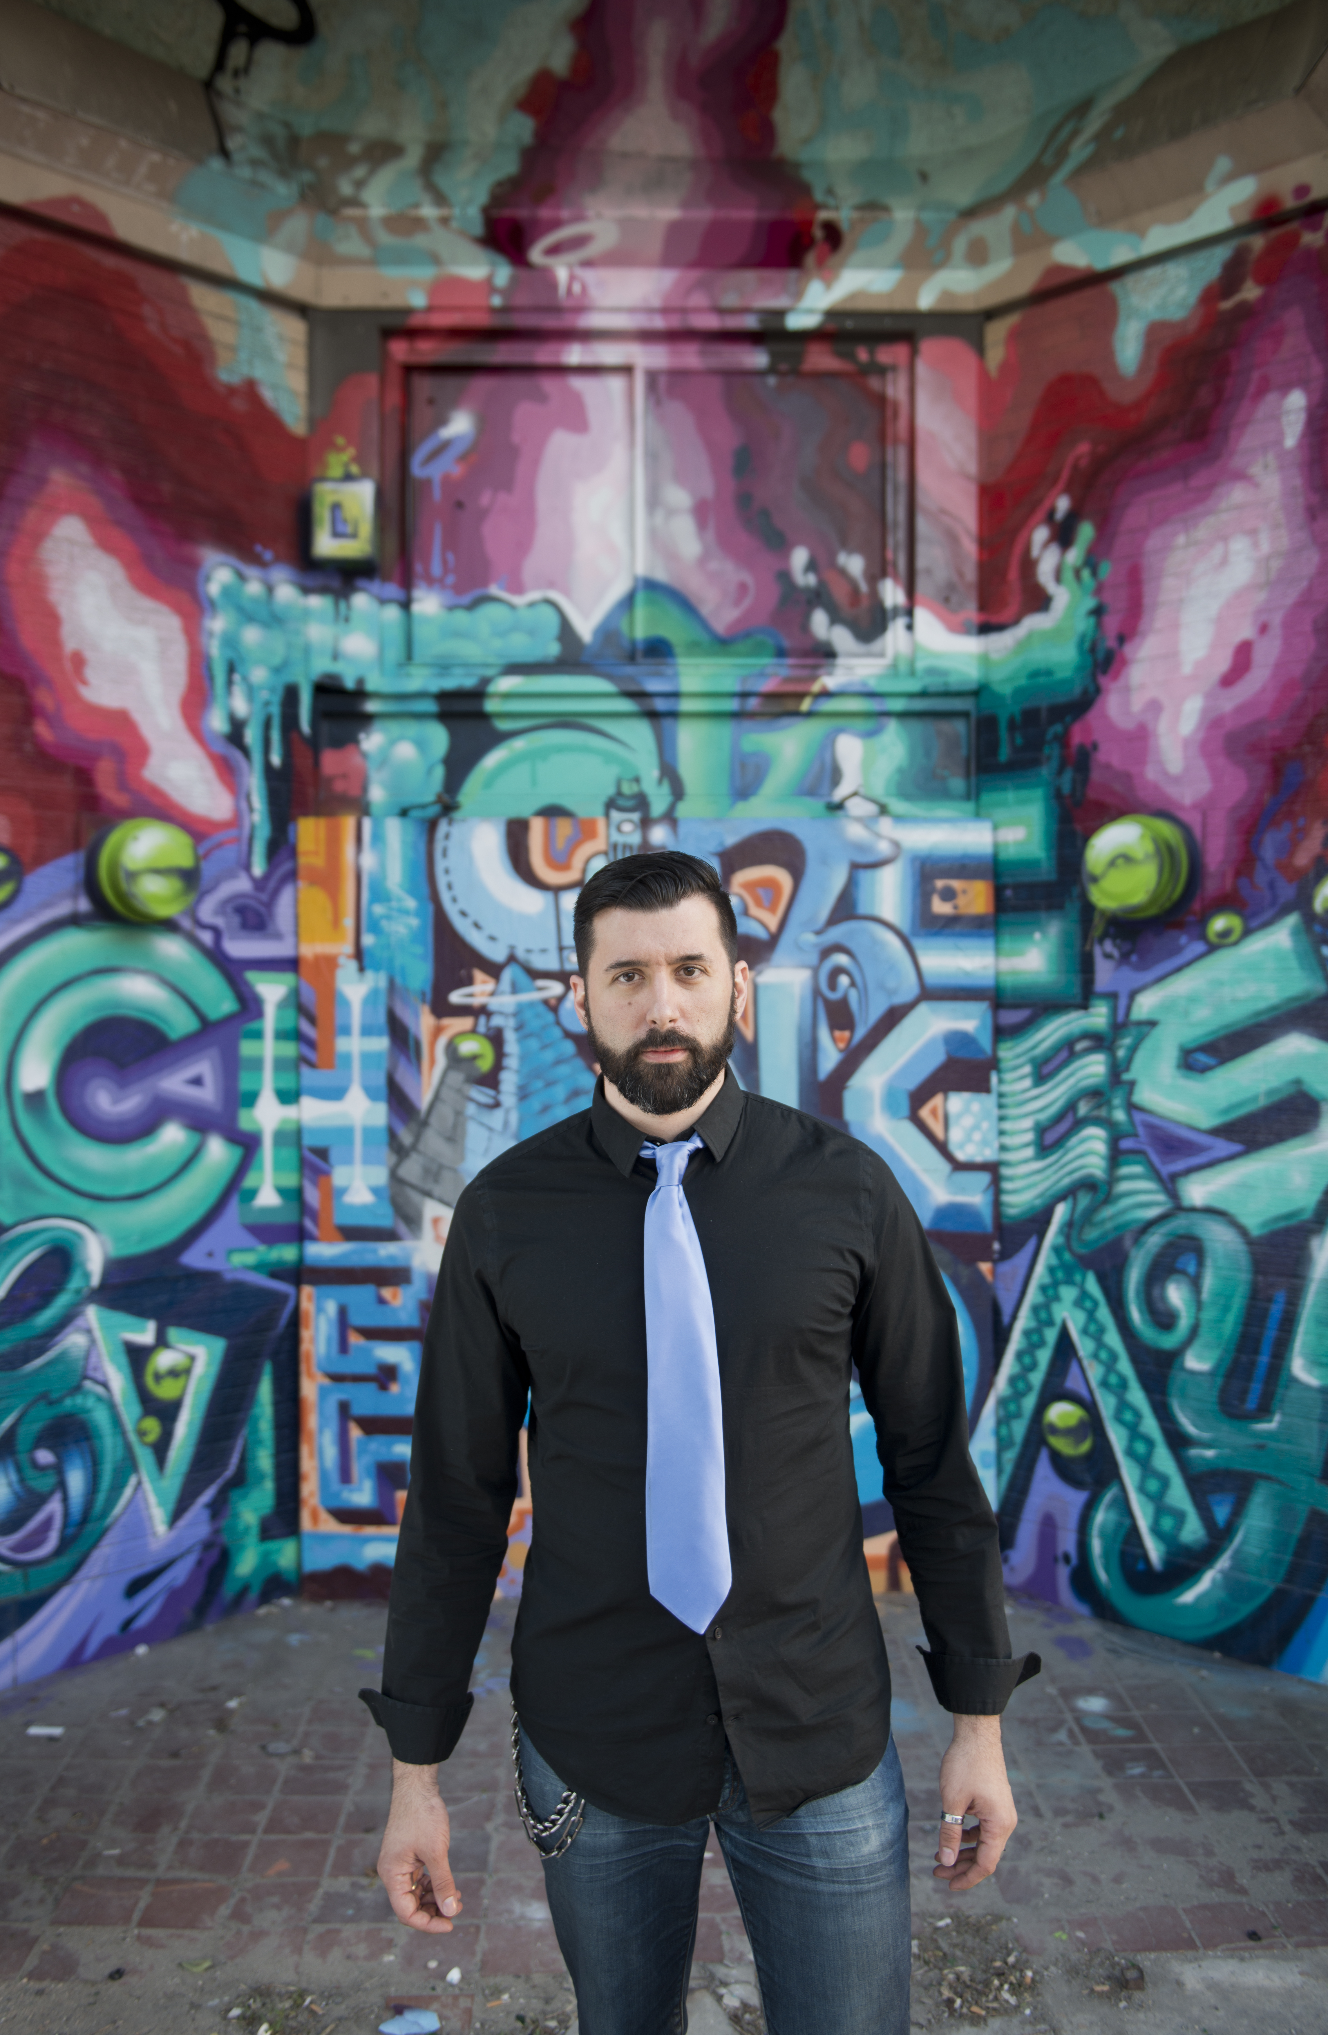
HOORAY!
YOU’RE DA!
(NOW GO FIX ALL THE GARBAGE YOU JUST EXPLOITED)
JOHNNY XMAS
SECURITY RESEARCHER @UPTAKE
@J0hnnyXm4s
Slides - https://github.com/johnnyxmas/talk_decks

